Slide 1
BATTLE OF NEIGHBORHOODS
APPLIED DATA SCIENCE CAPSTONE
BY RAHUL KUMAR SINGH

Slide 2
INTRODUCTION
Mumbai (formerly Known as Bombay) apart from being the busiest cosmopolitan city in India, is also the financial hub of the country, due to which people from different parts of the world live in the city. Due to the diversity in the cultural backgrounds of people, there are a thousand of restaurants in the city, that cater to a variety of cuisines.

Slide 3
DATA
To solve the above business problem, we shall need the following data: -
-A list of neighbourhoods in Mumbai
-Latitude and Longitude data of neighbourhoods- Latitude and longitude data could be extracted using the Geocoder package.
-Venue-related data- Venue related data could be extracted using the Foursquare API.

Slide 4
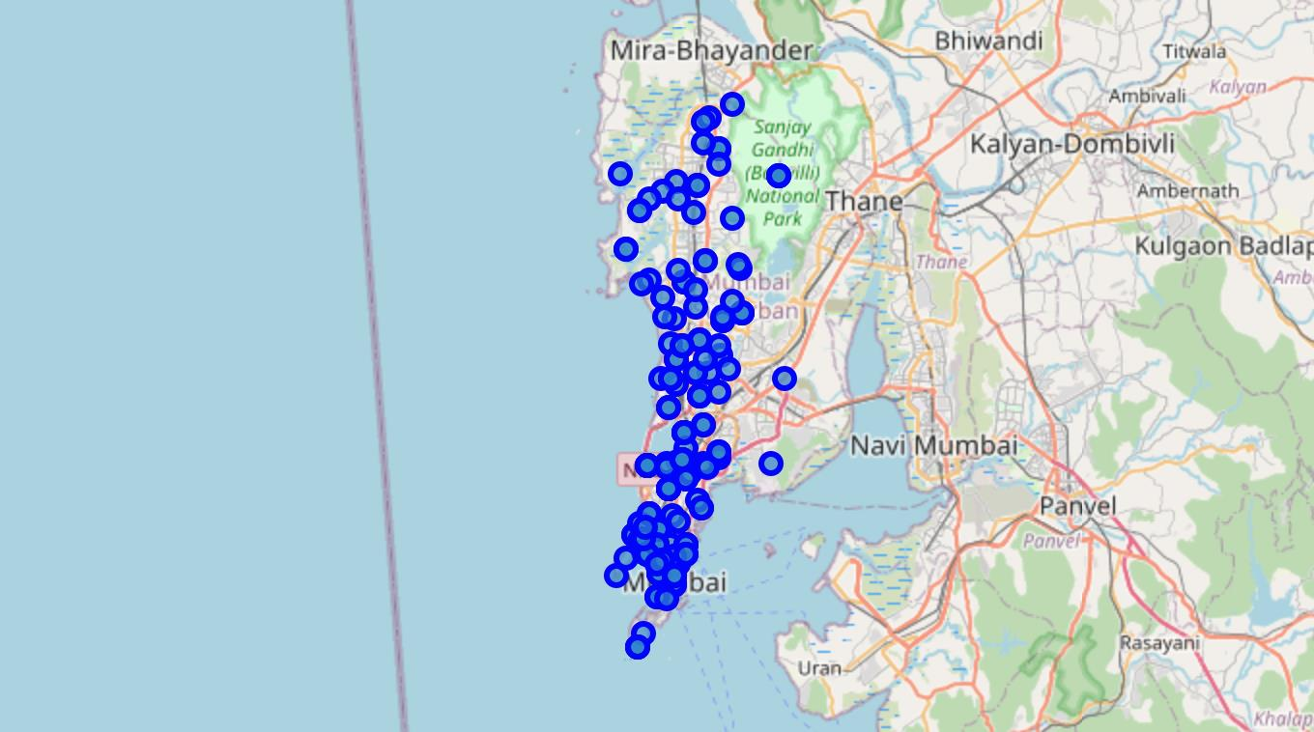
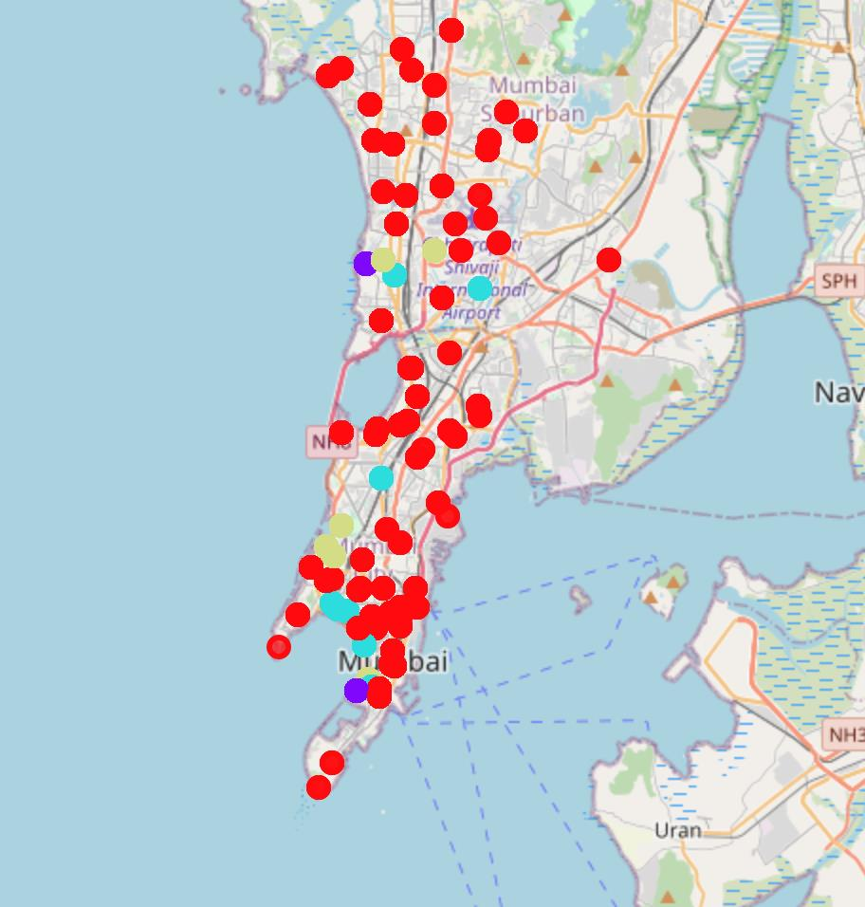
RESULTS SECTION
BEFORE CLUSTERING AFTER CLUSTERING
Cluster 0, Cluster 1, Cluster 2, Cluster 3

Slide 5
RESULTS SECTION (CONTD.)
As we can see below, cluster 0 has the least amount of Italian Restaurants, therefore it would be considered as the best area to open, a new Italian restaurant.

Slide 6
RESULTS SECTION (CONTD.)
Cluster 1 has moderate number of Italian Restaurants, therefore it won’t be the most ideal area to open a new Italian Restaurant.

Slide 7
RESULTS SECTION (CONTD.)
Cluster 2 has the most amount of Italian Restaurants, therefore opening a new Italian Restaurant over there would not be ideal.

Slide 8
RESULTS SECTION (CONTD.)
Cluster 3 has a moderate number of Italian Restaurants, therefore it won’t be the most ideal area to open a new Italian restaurant.

Slide 9
CONCLUSION
The accuracy of determining the best places to open an Italian Restaurant can be improved by not just taking the number of Italian Restaurants into consideration, but also taking into consideration the demographic of a certain area, and determining the food preferences of the people in a certain neighbourhood. Since, that data is not readily available, and can only be gathered through a widespread survey, for the time being only the number of restaurants have been used to find a solution to the posed Business problem. In the future, when such data is available we can update our findings by further incorporating the extra data.
Thus to conclude the study, one can say that there is always, scope for more improvement, by finding more relevant data and increase its accuracy to narrow down the study.

